Slide 1
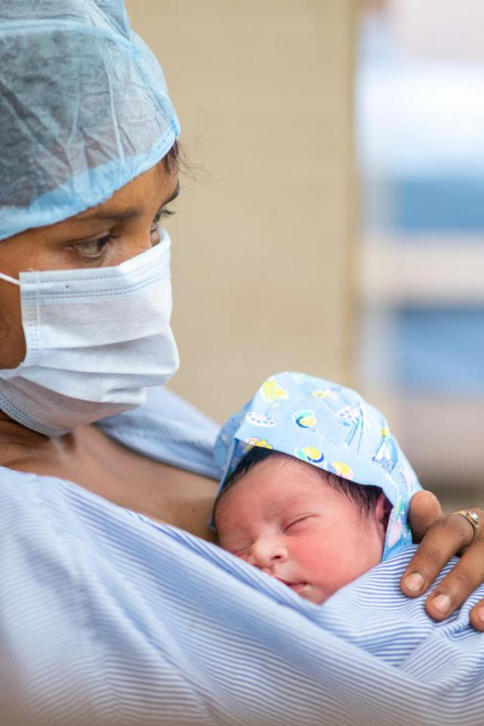
maternal health risk Analysis
By:
Anju Jadhao

Slide 2
Table of content
Introduction
Reason
Objective
Work Flow
Tools and Algorithms used for project
Data Description
Data Preprocessing
Data Visualization
Data Partition
Model Train and Test Accuracy
Deployment
Challenges in the Project
Advantages
Application
Conclusion
Future Scope

Slide 3
introduction
Maternal health has been becoming a global concern because the lives of millions of women in reproductive age can be saved through maternal health care services.
Many pregnant women die from complications of pregnancy because of not having enough information about maternal health care during pregnancy and post-pregnancy
This project of machine Learning, it’s aim is to predict the level of risk that a pregnant women can have regarding some features like Age, SystolicBP, BloodSugar, BodyTemp and HeartRate.

Slide 4
Why I choose this project
Maternal health is a crucial aspect of public health, and addressing maternal health risks can have a direct positive impact on both mothers and their children.
By focusing on this area, I have the opportunity to contribute to reducing maternal mortality rates, improving pregnancy outcomes, and enhancing the overall well-being of mothers and infants.

Slide 5
Objective
To develop a predictive model for maternal health risks using a dataset consisting of various maternal health indicators and risk factors.
Identify and analyze the factors that contribute to maternal health risks.
Improve early detection and intervention strategies for high-risk pregnancies.
Prediction of Maternal Health Risk Levels

Slide 6
WORK FLOW
Data Collection
Data import
Data Preprocessing
Collecting dataset from UCI repository
Imported data using pandas package
Manipulating data wherever needed
Data Visualization
Different graphs and charts to explain data pattern
Select best model
Checking Accuracy
Model Building
Decing the best model based on accuracies
Comparing accuracies of all the models
Build 3 logistic regression model

Slide 7
Tools and algorithms used for project
Jupiter notebook, python Language
Python Packages:
Pandas and NumPy for data analysis and calculation.
Matplot, Seaborn, Plotly for data Visualization.
Statsmodel and Sklearn for Machine learning.
Machine learning Algorithms:
Logistic Regression, Decision Tree, Random forest.
For Deployment: Visual Studio code, HTML and CSS

Slide 8
Data Desctiption
Variable Description and Identification
We can see total 6 variables, and each variables has 1014 observations. Here comes the description of all variables:
Age: Any ages in years when a women during pregnant.
SystolicBP: Upper value of Blood Pressure in mmHg.
DiastolicBP: Lower value of Blood Pressure in mmHg,
BS: Blood glucose levels is in terms of a molar concentration, mmol/L.
BodyTemp: Women body temperature.
HeartRate: A normal resting heart rate in beats per minute.
Risk Level: Predicted Risk Intensity Level during pregnancy considering the previous attribute.
Here, we have Risk Level as target variable, and the rest of the variables are predictor variables.

Slide 9
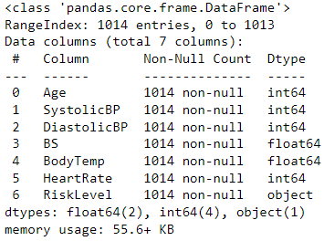
Data pre-processing
1. Data Type
Here we have 1040 rows
and 7 columns in data.
In data we have data type of
float, integer and object.

Slide 10
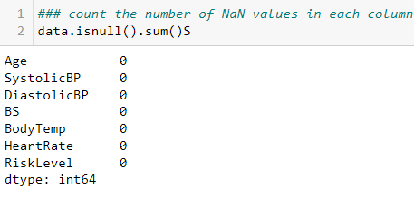
2. Identifying & Treatment of Missing value
Here we checked for missing values, we do not have missing values in our data

Slide 11
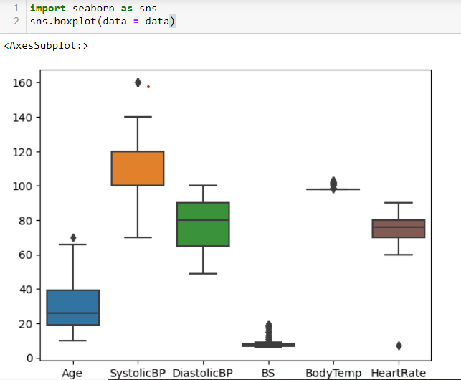
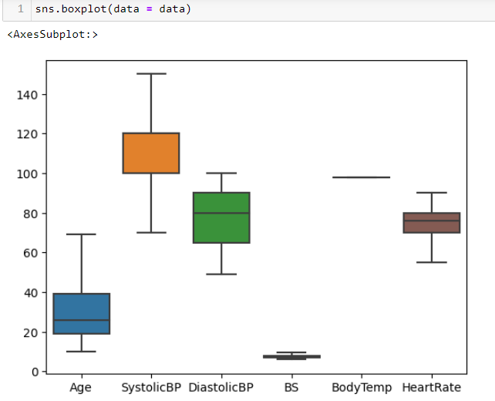
3. Treatment of outliers
Here we checked outliers, there is outliers in data and we Treat outliers Using Winsorizing Technique

Slide 12
4. Label Encoder
It is Technique that converts the categorical data in a numerical form so that they can be easily understood by machine learning algorithm and can make good predictions.
it enable grout of categorical data without losing any information
by using LabelEncoder().fit_transform we convert categorical data in to numerical for,
high:0
low:1
Mid:2

Slide 13
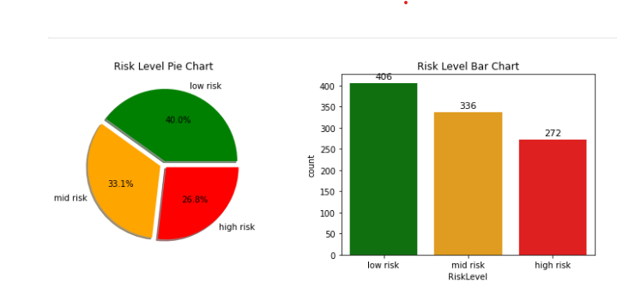
DATA VISUALIZATION

Slide 14
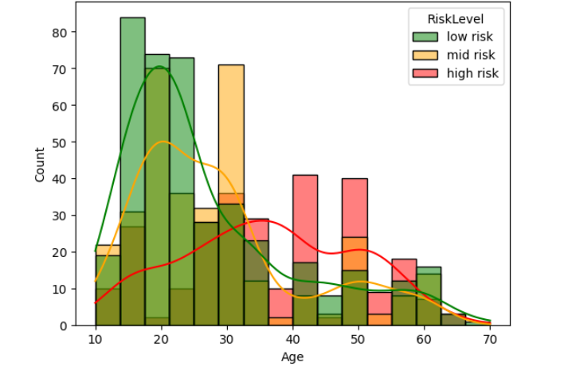
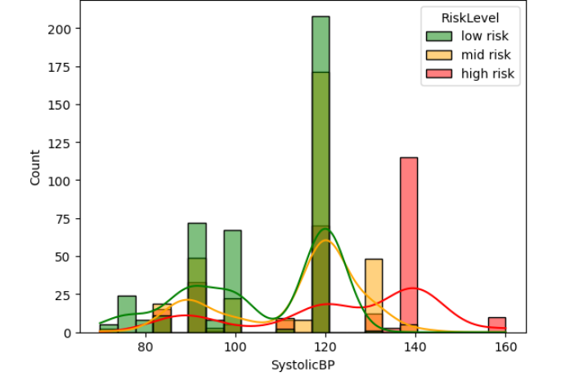
Risk level with respect to SystolicBP
Risk level with respect to Age

Slide 15
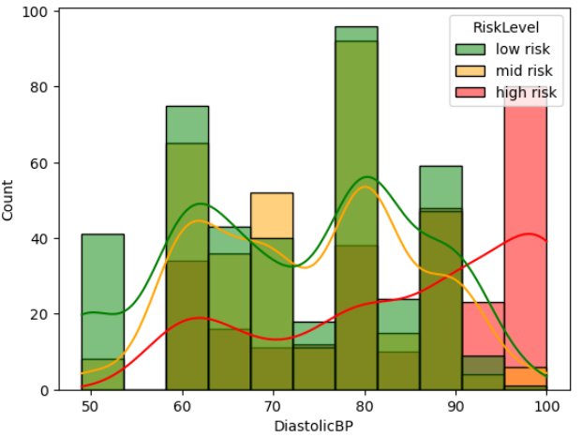
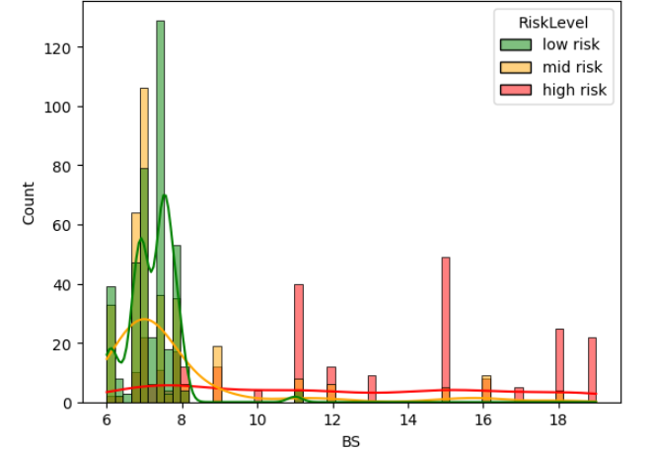
Risk level with respect to Diastolic BP
Risk level with respect to Blood Sugar

Slide 16
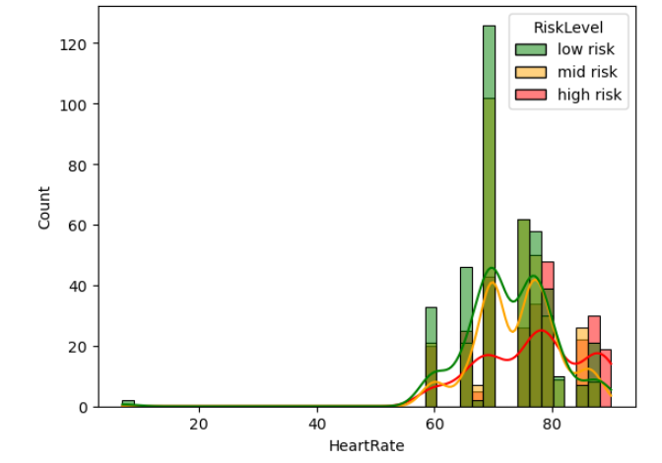
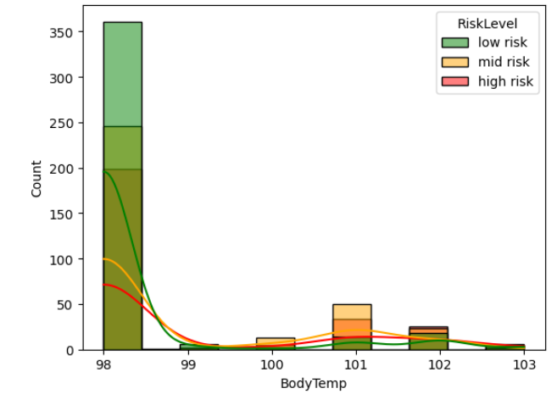
Risk level with respect to Heart Rate
Risk level with respect to bodytem p

Slide 17
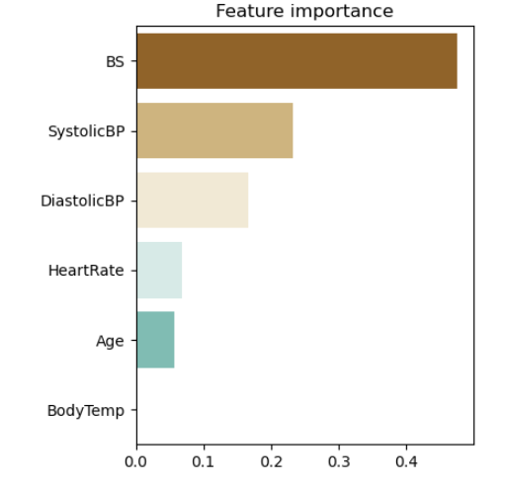
Features that impact on maternal health

Slide 18
Data Partition
Train-test split
Train dataset(70%)
Test dataset(30%)
Dataset
The data partition is done using train_test_split from sklearn library.
70% data is kept in train, whereas 30% is used for test.

Slide 19
Model train and test accuracy
We performed various machine learning models in this dataset.
As the accuracy of Random Forest model is satisfactory for both train and test data, we chose results of that model to present.
the evaluation method is used for the project is confusion matrix.
Models | Train Accuracy | Test Accuracy
Logistic Regression | 60 | 61
Decision Tree | 65 | 68
Random Forest | 70 | 73

Slide 20
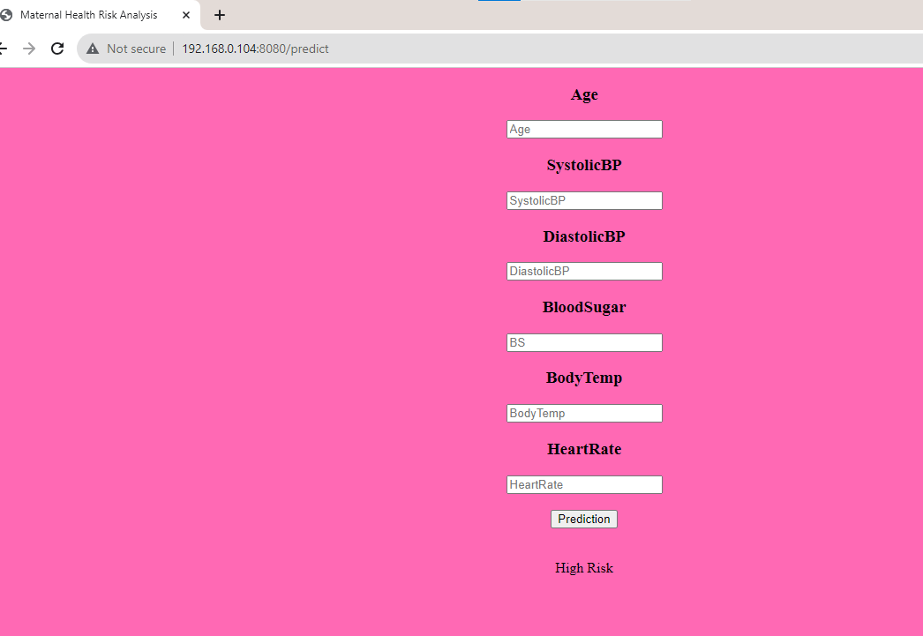
MODEL DEPLOYMENT

Slide 21
Challenges in the project
Dealing with missing values.
Identify and treatment outliers.
Dealing with hyper tuning parameters was one of the most challenging task.
Dealing with over fitting and under fitting model accuracy.
And the last but the least was selecting the best model among the all models.

Slide 22
advantages
Identifying maternal health risk at an early stage and reducing the chances of complication during pregnancy and childbirth.
Reduced maternal mortality rate.
Early detection and intervention for maternal health risk.
Improved maternal Health outcomes.

Slide 23
application
Build a mobile Application.
build wearable devices to collect additional health data such as heart rate, blood pressure, and activity levels.
This project can pay a crucial role in saving the lives of pregnant women and ensuring their well-being.

Slide 24
conclusion
After doing some analysis on this dataset, we can conclude that BS or blood glucose level is the most important variable in determining the health level of pregnant women. Pregnant women who have high blood glucose level tend to have high health risks.
The model was developed using a variety of machine learning algorithms, including logistics, decision tree, random forest. The best performing algorithm was the random forest algorithm, which achieved and accuracy of 70 %.
The maternal health risk dataset provides valuable insights into the risk associated with maternal health.

Slide 25
Future scope
Improve the accuracy and reliability of maternal health risk classification by incorporating a broader range of data source.
as more data becomes available and new research emerges, continually update and refine the model to enhance its accuracy and relevance.
integrating the classification model with real-time monitoring systems can enable continuous assessment of maternal health during pregnancy, this can involve using wearable devices, remote sensors , or mobile health application to collect and analyze data in real-time, by leveraging this data, the system can provide timely alerts and recommendations to both healthcare providers and expectant mothers, enabling proactive interventions.

Slide 26
Thank you

